Slide 1


A comparative analysis of design patterns for concurrent and parallel programming in object-oriented programming.
Code: - SE 450
Name: - Umme Athiya

Slide 2
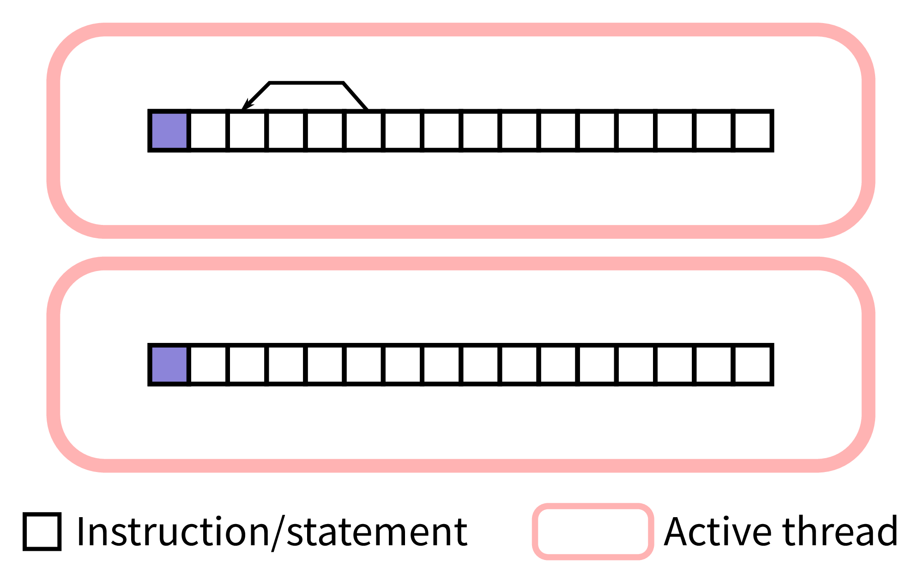

INTRODUCTION
Concurrent Programming
Parallel Programming
The execution of multiple independent tasks or processes simultaneously.
This can be achieved through processes, threads, or asynchronous programming.
Thread safety.
Synchronization.
Deadlocks & Rare Conditions.
A simultaneous execution of tasks to improve the performance and speed of a program.
It requires multiple processors or cores to divide the tasks into smaller independent subtasks.
Parallel Architecture.
Task Parallelism.
Communication & Coordination.
Load Balancing.
Key Concepts
Key Concepts

Slide 3





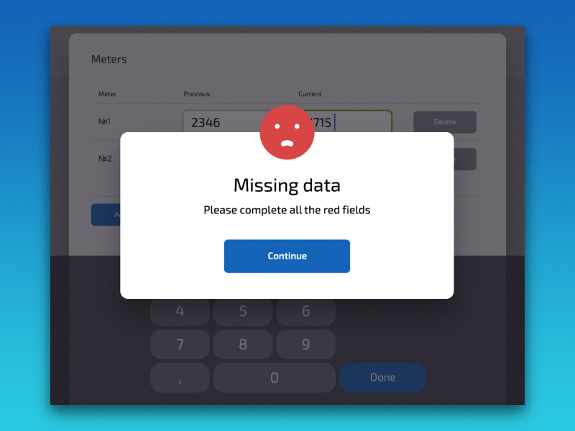

Role of Design patterns
They provide proven solutions to common design problems, promoting code reuse, maintainability, and scalability.
Offer solutions for managing complexity, ensuring thread safety, promoting scalability, and enhancing the overall maintainability of software systems.
Specific Roles
Abstraction
Scalability
Encapsulation
moveforward( ) { } moveBackward( ) { }
Data
Methods
Thread Synchronization
Error Handling
Task Decomposition

Slide 4

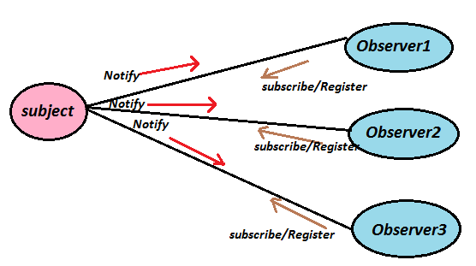


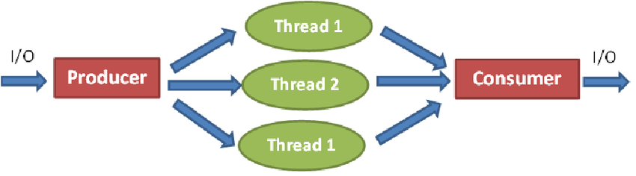

Design patterns in concurrent Programming
Singleton
Observer Pattern
Producer-Consumer
To create a single, globally accessible resource manager or configuration manager in a concurrent environment.
Event-driven systems.
One component notifies multiple observers about state changes concurrently.
One or more producer threads produce objects which are queued up, and then consumed by one or more consumer threads.
Reader-Writer Lock
Manage access to shared resources, allowing multiple readers but only one writer at a time.

Slide 5
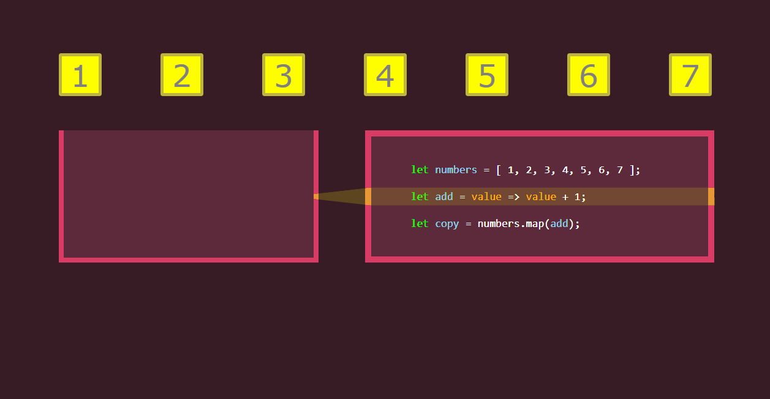
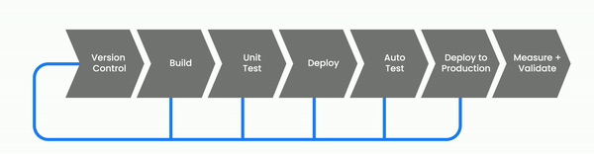
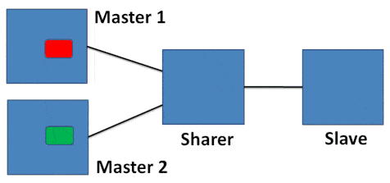
Design patterns in parallel Programming
MapReduce
Pipeline Pattern
Master-Worker
Divide a computation into smaller tasks that can be executed in parallel, then combine the results.
Divide a computation into stages, with each stage processing data and passing it to the next stage.
Divide a task into a set of subtasks and assign them to worker processes, coordinated by a master process.

Slide 6
Comparative analysis
Concurrent Programming
Parallel Programming
1. Singleton
1. Singleton
Issue: - May cause contention and synchronization overhead, posing potential performance bottlenecks.
Solution: - Use lazy initialization.
Issue: - If shared resources need to be managed, similar synchronization concerns may arise.
Solution: - Use lock-free data structures or optimistic concurrency control
2. Factory Method
2. Factory Method
Benefits: - Helps to create and manage instances of classes in a thread-safe manner.
Considerations: - Ensure proper synchronization mechanism is followed.
Benefits: - Each parallel tasks has its own factory, reduces contention & improves performance.
Considerations: - Ensure proper synchronization mechanism is followed for shared resources in the factory.
3. Observer Pattern
3. Observer Pattern
Benefits: - Multiple observers asynchronously respond to events without blocking the main execution thread.
Considerations: - Ensure proper handling of asynchronous notifications from multiple threads.
Benefits: - Multiple tasks can concurrently process events and notify their respective observers.
Considerations: - Thread safety is crucial, especially when notifying observers from multiple parallel tasks.

Slide 7



Modern software development
Beneficials
Performance Optimization.
Scalability.
Multitasking & Multithreading.
Efficient Resource Utilization.
Responsive User Interface.
Adaptability to modern hardware.

Slide 8


Case Study
Concurrent Programming
Parallel Programming
User Authentication & Authorization
Load Balancing
Challenge: Ensuring even distribution of workload among processing units to maximize resource utilization.
Solution: Employ the Load Balancer pattern to dynamically distribute tasks based on the workload of each processing unit.
Challenge: Simultaneously handling user authentication and authorization requests to ensure secure access to chat features.
Solution: Apply the Singleton pattern to manage a central authentication service.
Use appropriate synchronization mechanism.

Slide 9
LIVE DEMO

Slide 10
THANK YOU

